Slide 1



Bodega Vistalba
Recommendations for Visitor Experience
Tess Kamauff,
Eric MacBlane,
Morgan Sasser,
Emmett Saulnier,
Bill Su

Slide 2
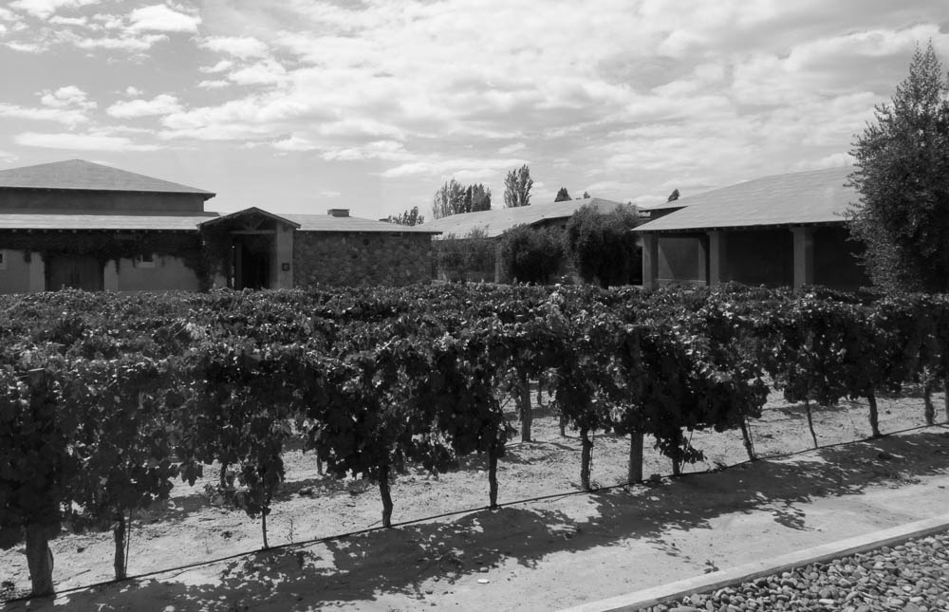
Executive Summary
Optimize checkout with two people
Make tour script unique
Increase consumer knowledge
Use signage throughout tour

Slide 3
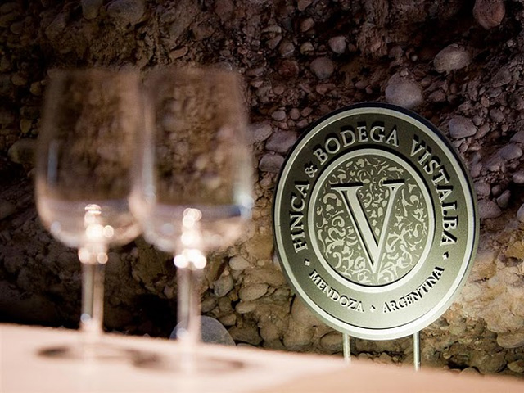
Our Goals

Slide 4
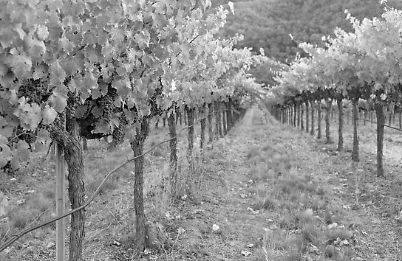
Increase profits by increasing spending per visitor
Emphasize Brand Uniqueness
Increase Knowledge of Products
Decrease Wait Time
Increase Branding using Signage
Increase Profitability at Point of Sale

Slide 5
Analysis of Checkout Processes

Slide 6
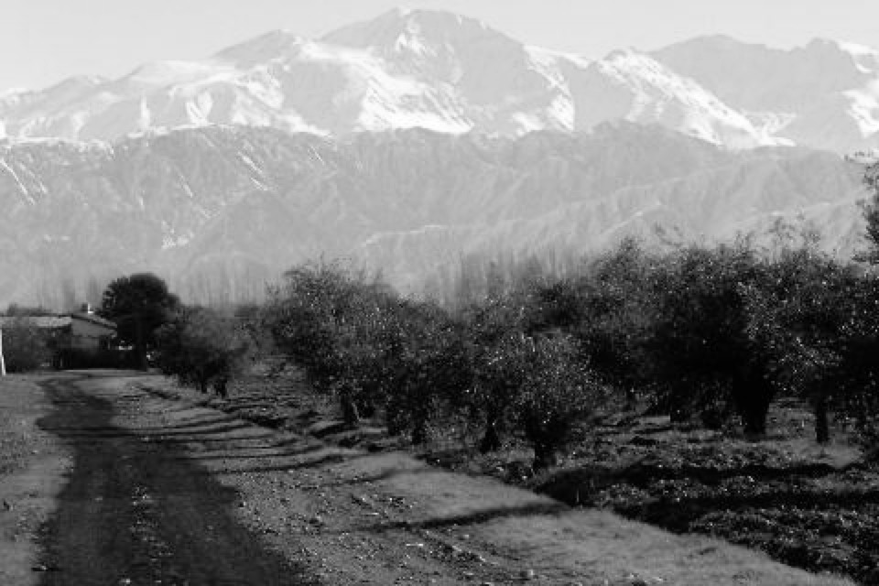
Checkout time is optimized with two staff members
36% Decrease
Notes:
Based on the problem statement we received, our first check was looking into the checkout process to examine backlogging
We worked with the staff to compile a process flow, that we used to simulate the checkout process after 100 “example tours”
These simulations allowed us to estimate the impact of various levels of staff at checkout
We realized:
(1) With two staff, checkout was 36% than with one staff member
(2) Additional staff after 2 did not change anything
(3) Checkout did not seem to be a significant time constraint (i.e., 2-3 minutes)

Slide 7
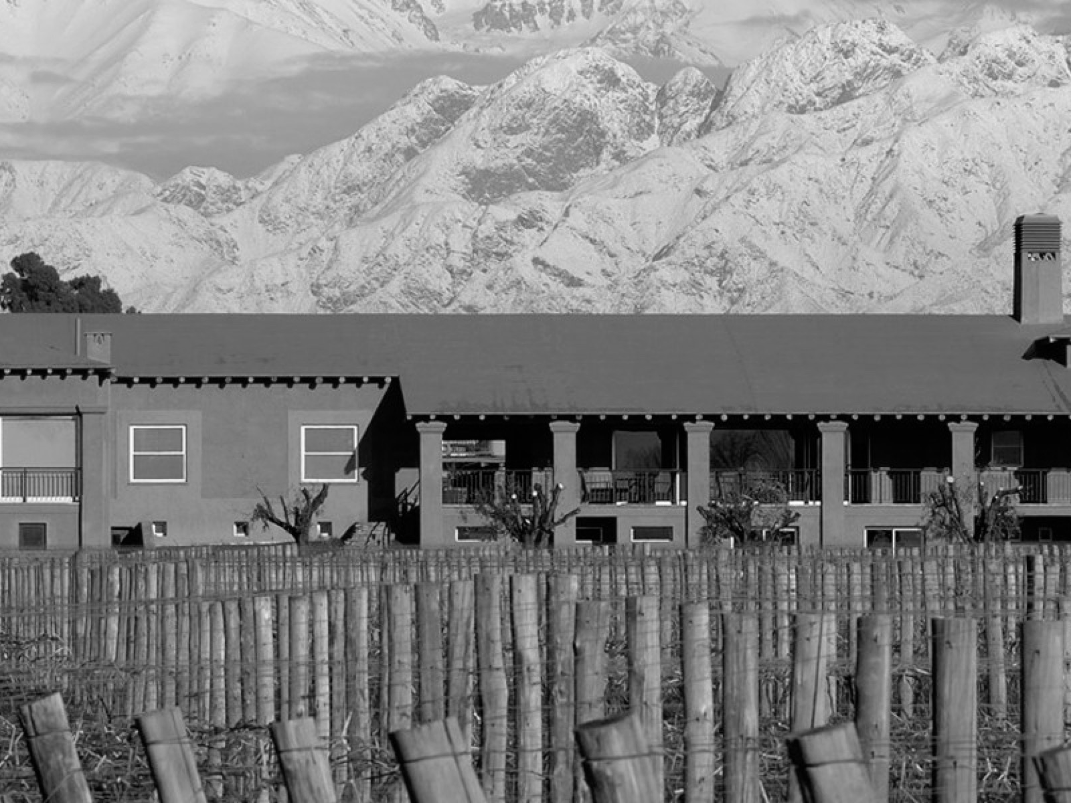
Tour guides spend little time checking out visitors
Tour Guide Time Use
Guiding
(4%)
Notes:
To reinforce our suspicion about a lack of a constraint in the checkout process, we tracked the utilization of tour guides over the course of a day
Only 4% of a tour guide’s time was spent on checkout, demonstrating low resource utilization in that area
With these two findings, we advise that the checkout process remains as is: one person in general, and two people after a tour

Slide 8
Make Tour Unique to Bodega Vistalba

Slide 9
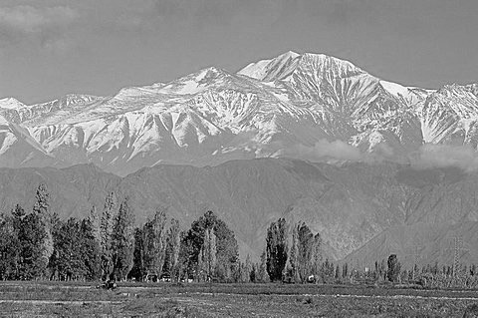
Make tours personal, unique, and customizable
Personal Greeting
Visitors are comfortable and informed
Unique Tour
Brand stories; highlight scenery
Flexible Schedule
Adapt to time restraints
Notes:
Two key elements – focus on brand Korhonen, et al. demonstrated customers are more inclined to make purchases with brand info
Flexible schedule – save time

Slide 10
Increase Visitor Knowledge

Slide 11
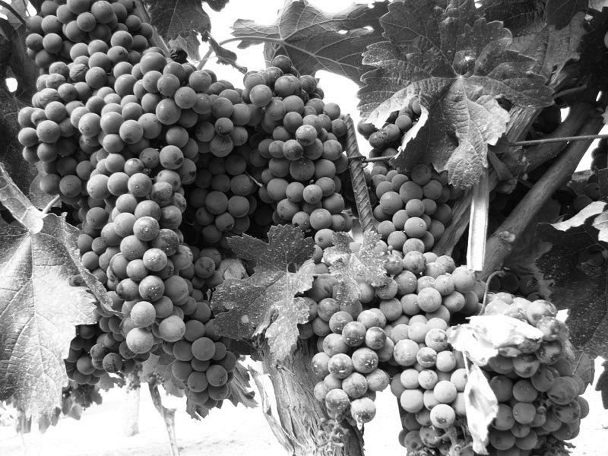
Wine catalogs will increase exposure to full product line
Provides visitors material to read while waiting for tour to begin.
Allows visitors to learn about wines they did not taste.
Reduces questions visitors have to ask tour guides at checkout.
Notes:
Something to do while they wait – WE HAVE NOTICED LONG WAIT TIMES
Only taste four, this lets them read about more – reduce uncertainty, increase purchases at checkout
Reduces the number of questions they have to ask the guides

Slide 12
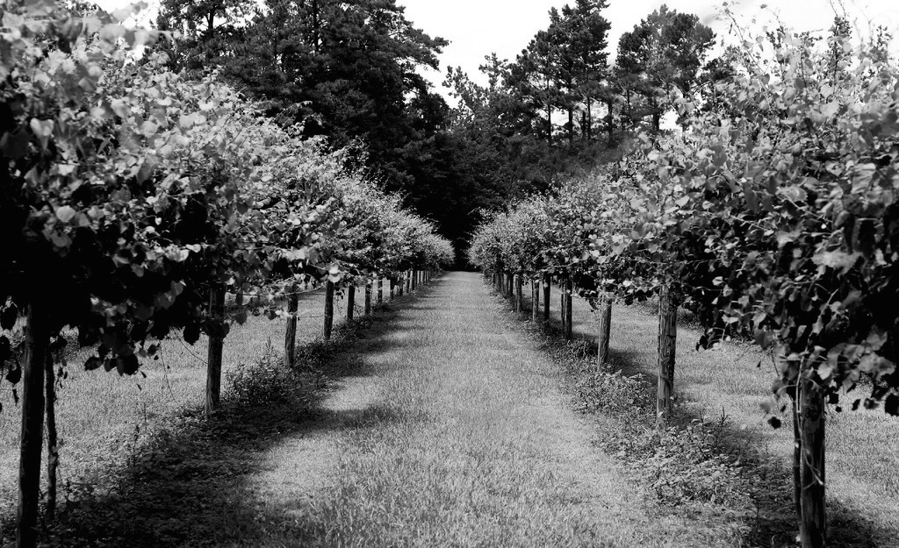
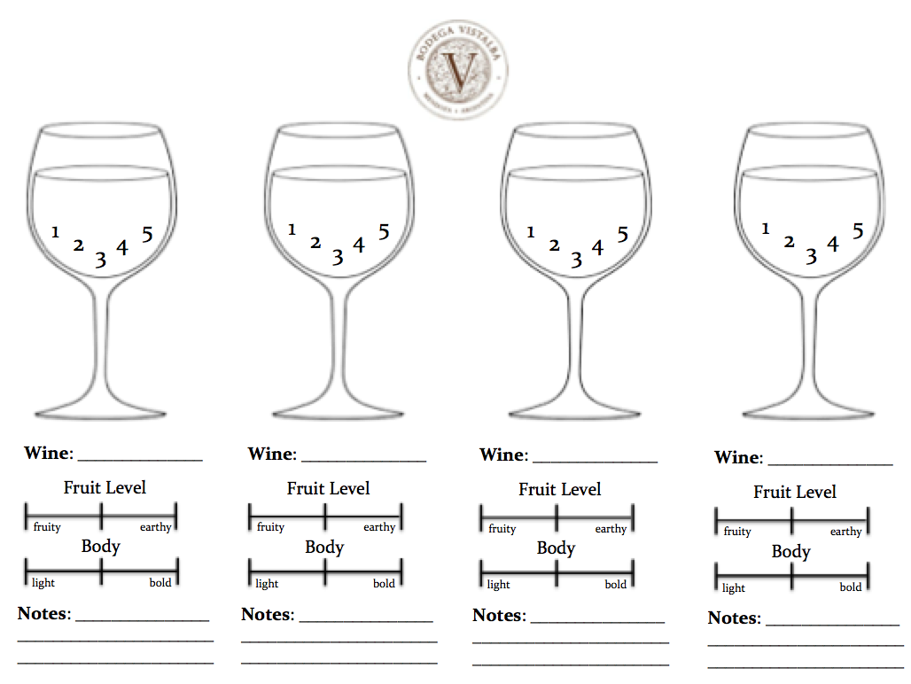
Tasting cards will increase interaction during tasting

Slide 13
Display Signage During Consumer Journey
Notes:
Bill

Slide 14

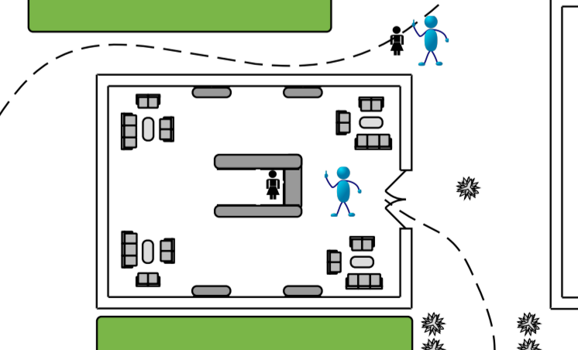
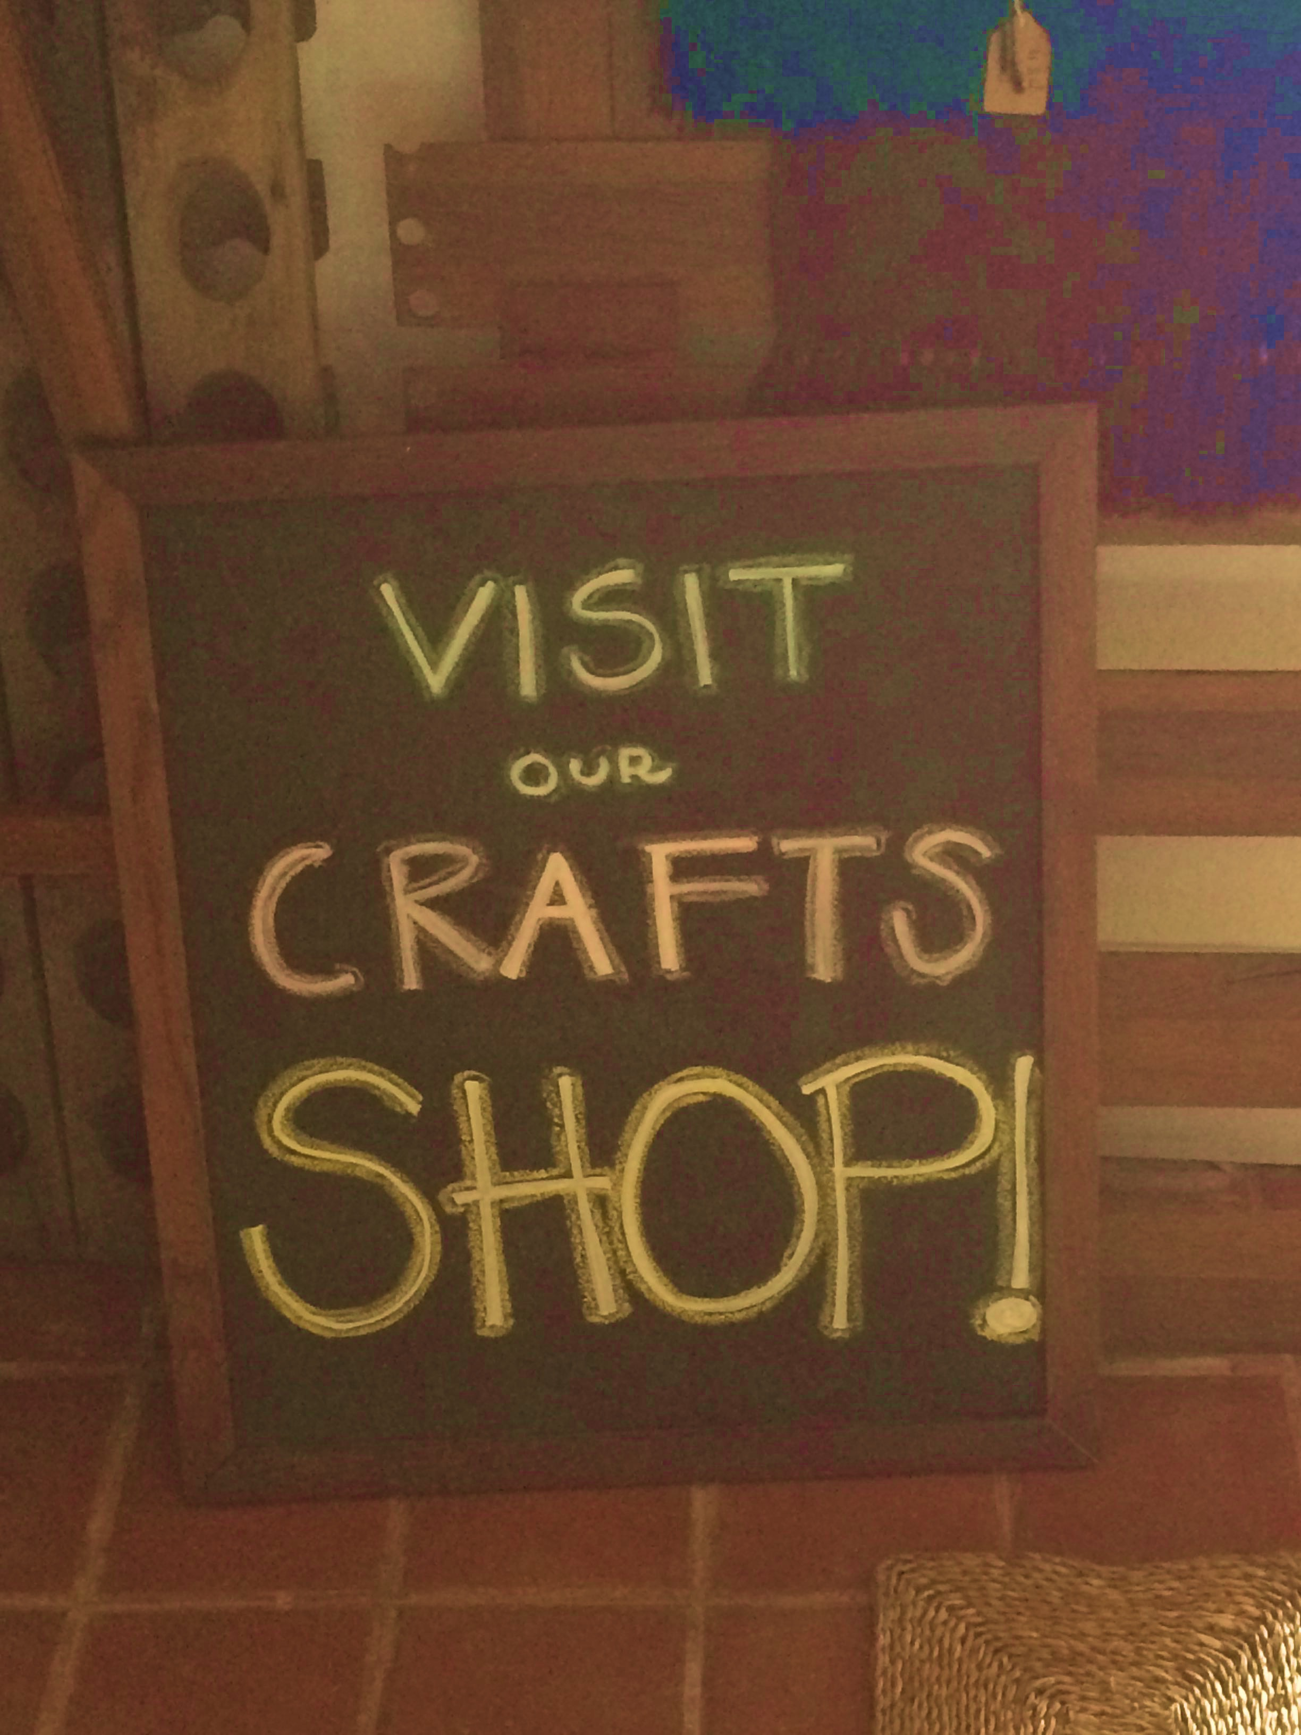

Increasing signage throughout tour will drive sales
Notes:
Bill

Slide 15
Testing, Financial Analysis
and Conclusion

Slide 16
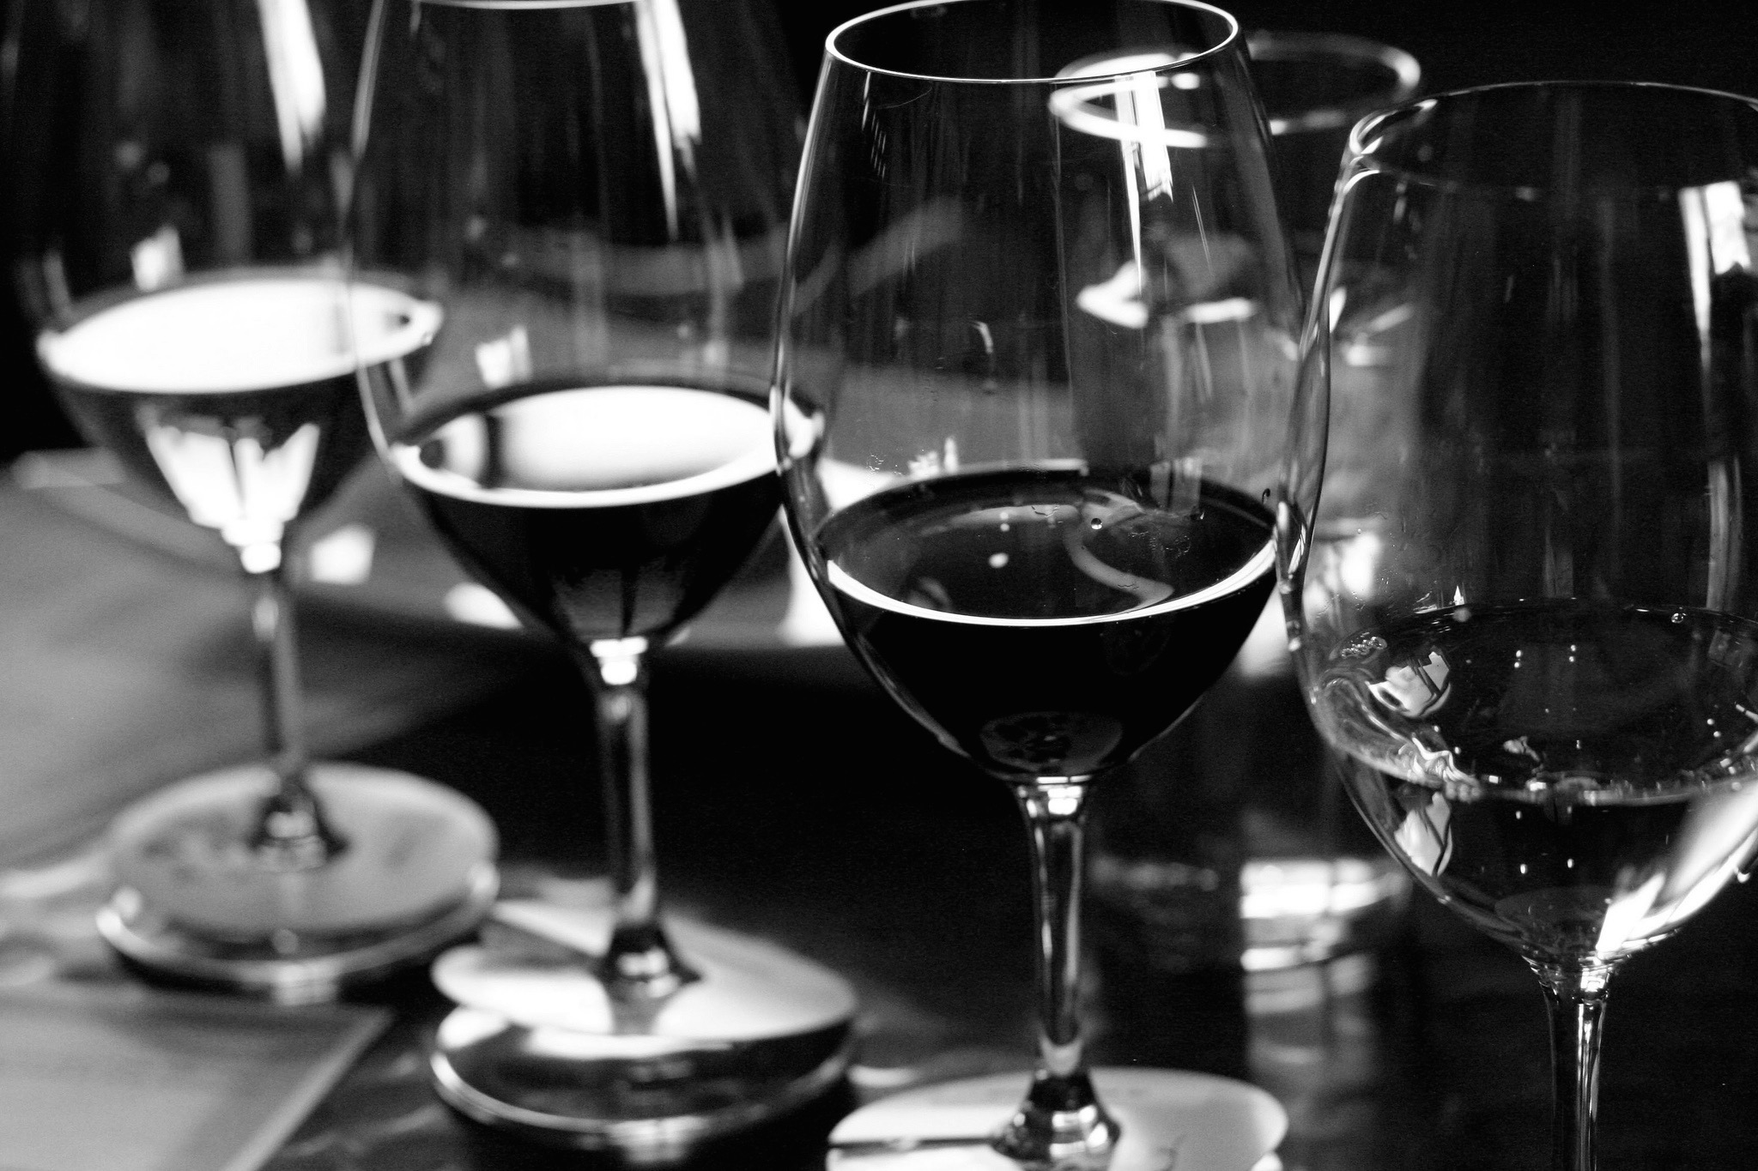
Test recommendations to determine effectiveness
1
Control Group
Use current operations
2
Treatment Group
Implement recommendations
3
Decision
Determine which method drives more revenue

Slide 17

Break-even time is low for each change
7.2
4.5
2.0
N/A
0.2
N/A
Notes:
Shows revenue increase as % versus payoff time in months; payoff time overall is low, and ultimately will increase annual revenue by $140,000

Slide 18
14%
Increase in revenue
$140,000 Annually
Staffing two persons at Point of Sale will decrease wait time by 36%.
Changing scripts to focus on brands and wines will increase revenue by 5%.
Presenting information on each wine at the Point of Sale will increase revenue by 6%.
Adding deliberate signage can increase revenue by 3%.

Slide 19
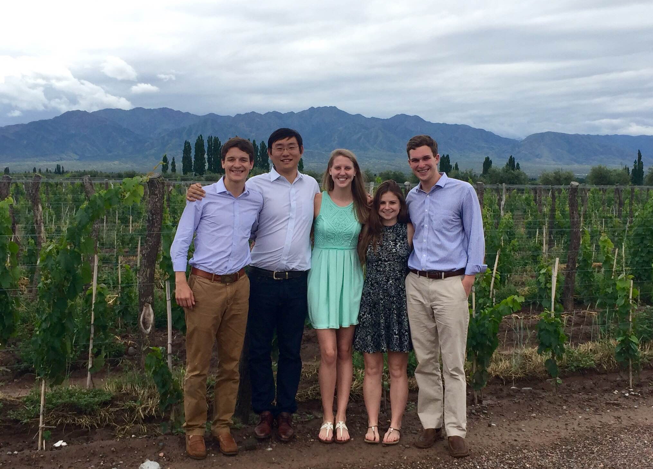
Thank You!
Questions?

